Slide 1
MACHINE LEARNING PIPELINE
ML pipeline with KNIME Analytics Platform

Slide 2
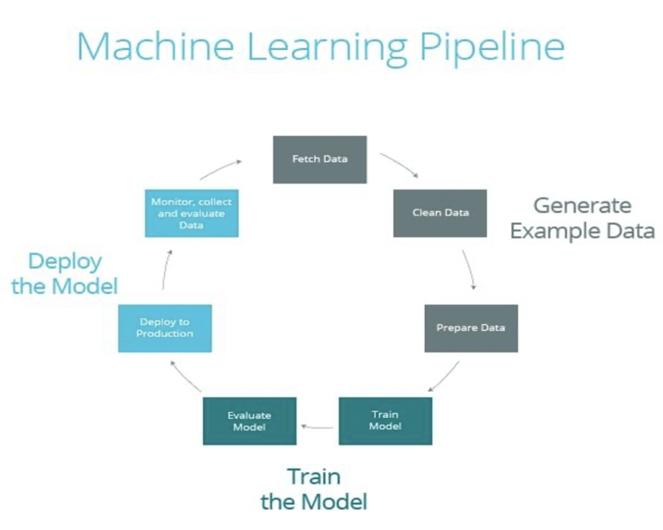
Introduction
Machine learning pipelines consist of a cycle and multiple sequential steps that do everything from data extraction and preprocessing to model training and deployment.
ML pipeline can be represent as in figure below.

Slide 3
ML/DL life cycle…
The first step of ML is data capture and data preprocessing because not all raw data comes to you as pristine as it can be.
The data processing involve data cleaning and analysing before model training.
Before undergo model training, you have to be sure of your machine learning problems (is it classification? Or regression?) and what kind of ML algorithm you can implement in the model training.
Essentially you have to split your cleaned data into train, validation and test set.
Train and validation dataset is used for ML model training, while test dataset is used for model evaluation.
If you’re satisfied with the model performance, you can start deploy the trained model with the real data.

Slide 4
Building a ML/DL data pipeline
Suppose that you already have a trained model. You wanted to make a ML data pipeline and make prediction from a real-event-streaming data such as sensor reading etc and stored the data into a database.
But how can you stream this real-event-data to your trained model?
The answer is Apache Kafka.
Apache Kafka is an open-source distributed event streaming platform used by thousands of companies for high-performance data pipelines, streaming analytics, data integration, and mission-critical applications.
In this workflow, I will show you how to build a ML data pipeline using Kafka and how to set-up the kafka container using docker and docker-compose

Slide 5
KAFKA Integration in KNIME
KNIME Analytics Platform provides the kafka extensions that allows the users to integrate KNIME workflow with streaming pub mechanism.
The Kafka extensions in KNIME Version 3.6 and higher provides:
Kafka Connector
Kafka Consumer
Kafka Producer
In KNIME you can straightway use this nodes to stream data, but first you have to set up kafka cluster and zookeeper cluster and create containers for kafka producer and kafka consumer

Slide 6
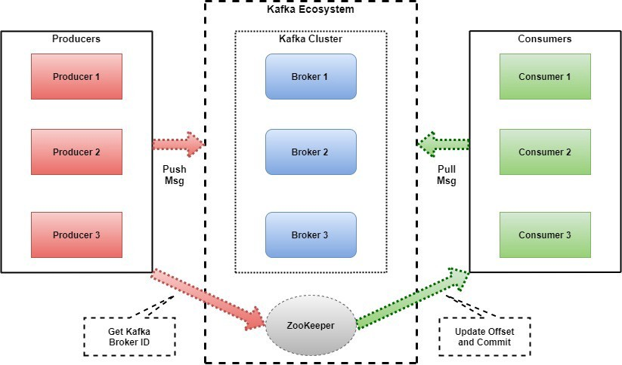
KAFKA ARCHITECTURE

Slide 7
KAFKA WORKING TERMINOLOGY

Slide 8
INSTALL KAFKA AND SETUP FIRST KAFKA CLUSTERS
You can refer to Basic Kafka Tutorial on how to install kafka, setup your first kafka cluster and run producer and consumer

Slide 9
WORKFLOW EXAMPLE

Slide 10
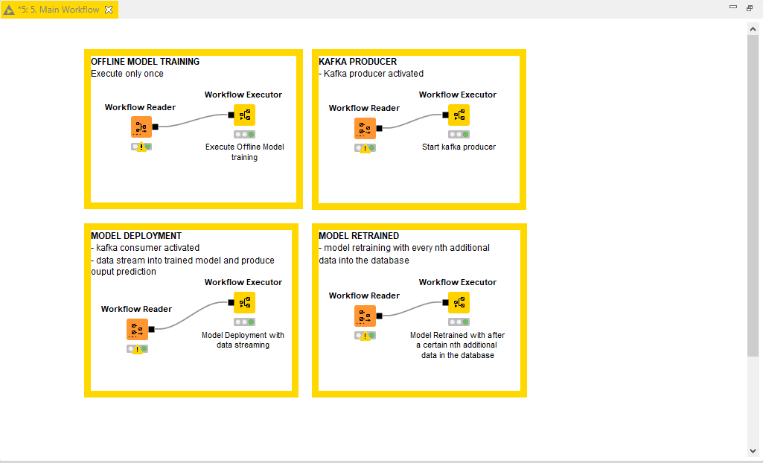
ML pipeline Workflow Overview
The main objective of this workflows is to implement traditional model training and deploy the trained model to a real-data-streaming using kafka. The data is then saved in database to be used for the model retraining after a certain nth of data
There are four workflows build as following:-

Slide 11
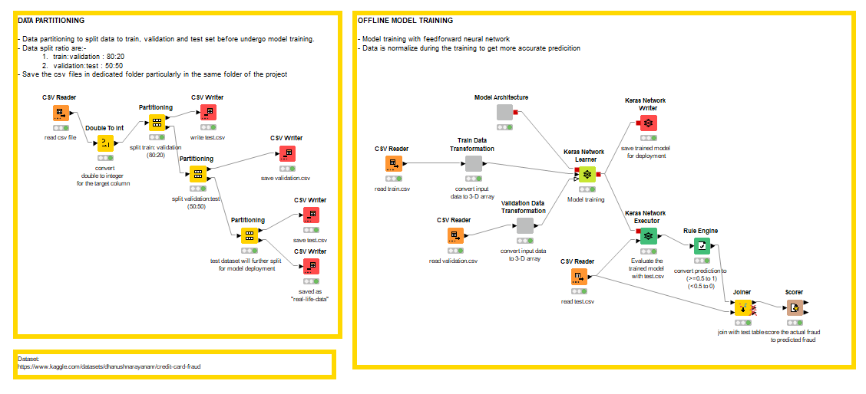
OFFLINE MODEL TRAINING
This workflow consists of DATA PARTITIONING and MODEL TRAINING.
In data partitioning section, raw data is split to train and validation (80:20), then test dataset is further split to validation and test dataset (50:50).
Test dataset the further split to test and real-time dataset (50:50)
Real-time dataset will be stream through kafka topics in Model Deployment Workflow

Slide 12
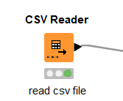
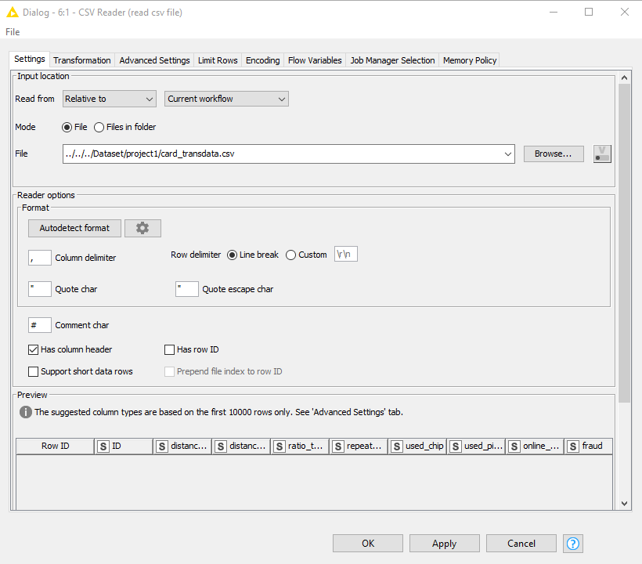
OFFLINE MODEL TRAINING
CSV Reader - Data loading and importing
For data loading and importing, reader node can be used.

Slide 13
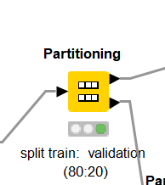
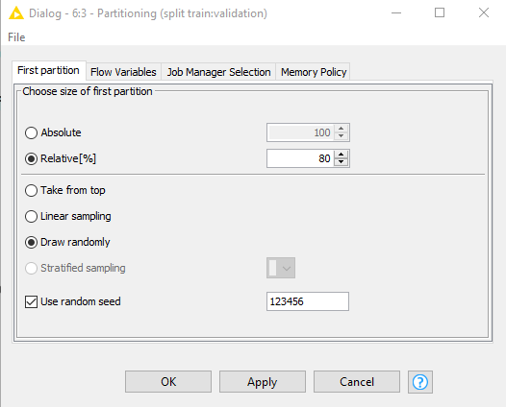
OFFLINE MODEL TRAINING
Partitioning - Data loading and partitioning
Data partitioning node can be used to partition your data

Slide 14
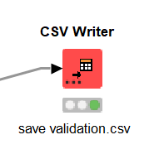
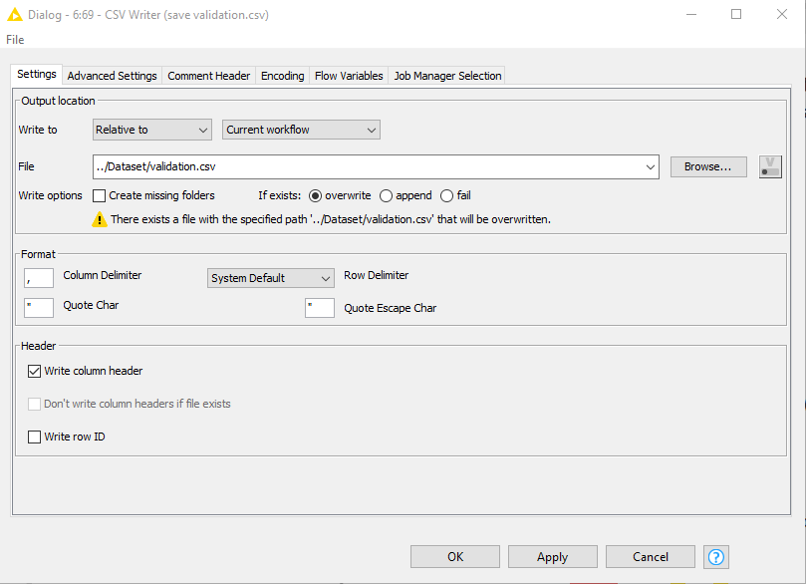
OFFLINE MODEL TRAINING
CSV Writer - Saving the data partitioned to .csv file
CSV writer node can be used to write and save the .csv file

Slide 15
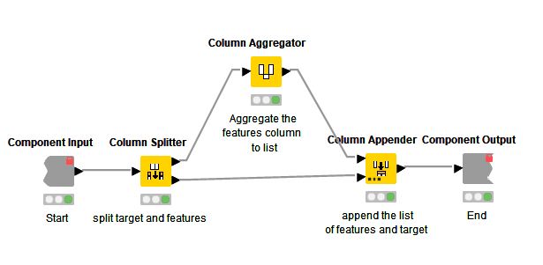
OFFLINE MODEL TRAINING
This workflow implementing deep learning approach using feedforward neural network.
This workflow use keras with tensorflow backend framework.
Before we start, we need to transform the data to 3-dimensional array.
2
1
3

Slide 16
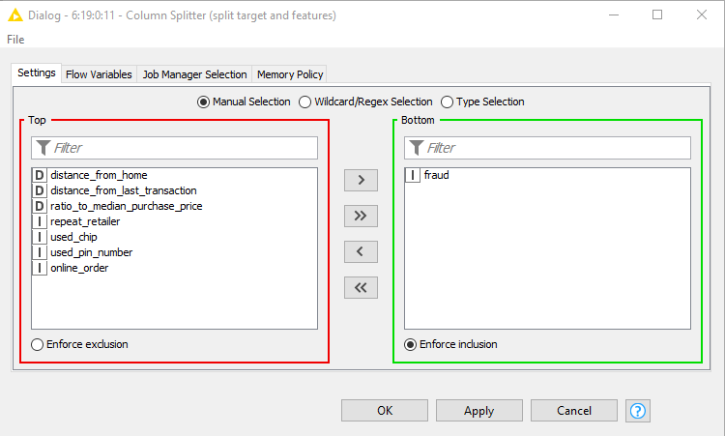
OFFLINE MODEL TRAINING
Column Splitter Node - to split the Target and the Features
Target column
Features column

Slide 17
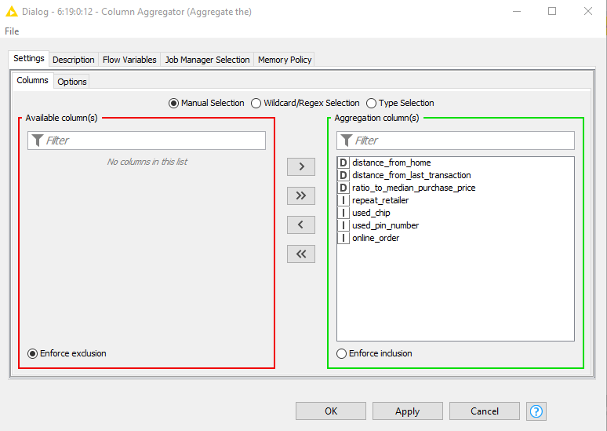
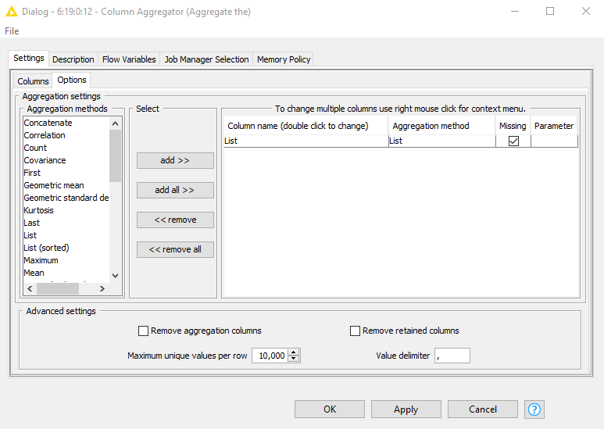
OFFLINE MODEL TRAINING
Column Aggregator - to aggregate the features column to list of features
Alternatively, you also can use Create Collection Column Node.
At the Column tab, select all the Features columns
At the Options tab, select the aggregation method

Slide 18
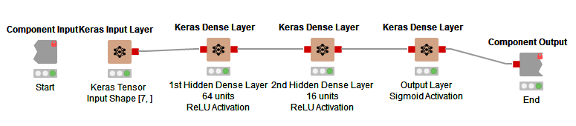
OFFLINE MODEL TRAINING
Model Architecture of the feedforward neural network consist as following layers:-
Keras Input Layer - Creates a new Keras Deep Learning Network with the specified shape, type, and batch size
Keras Dense Layer - A densely connected layer that connects each unit of the layer input with each output unit of this layer

Slide 19
OFFLINE MODEL TRAINING

Slide 20
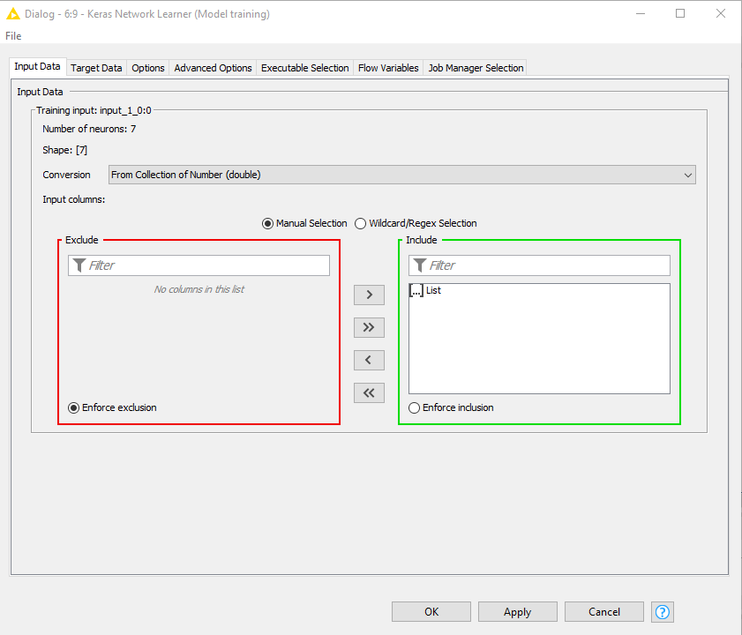
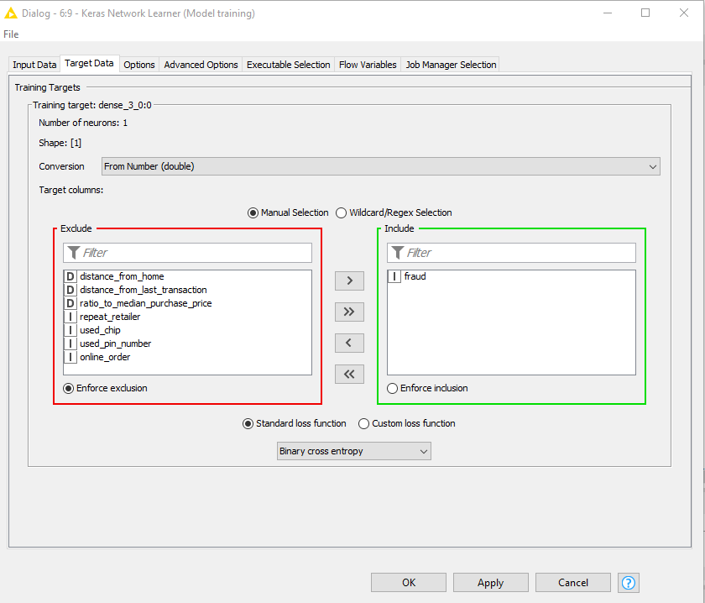
OFFLINE MODEL TRAINING
Model compilation and training

Slide 21
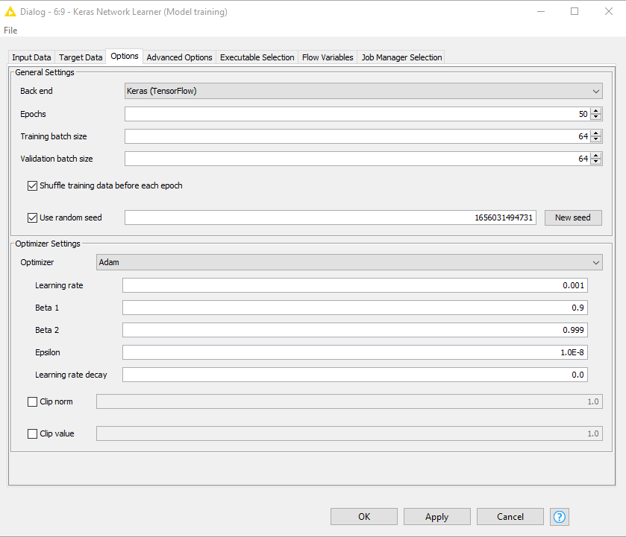

Slide 22
OFFLINE MODEL TRAINING
Model evaluation and scoring

Slide 23
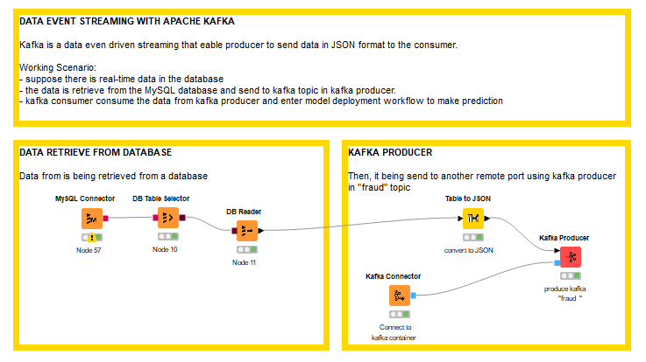
KAFKA PRODUCER WORKFLOW

Slide 24
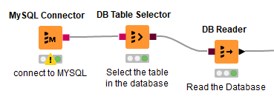
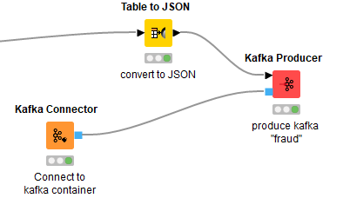
KAFKA PRODUCER WORKFLOW
In here we already learn how to install kafka and setup kafka cluster.
Suppose that you have to retrieve data from a database and stream data through kafka topic.
4
1
2
3
6
5

Slide 25
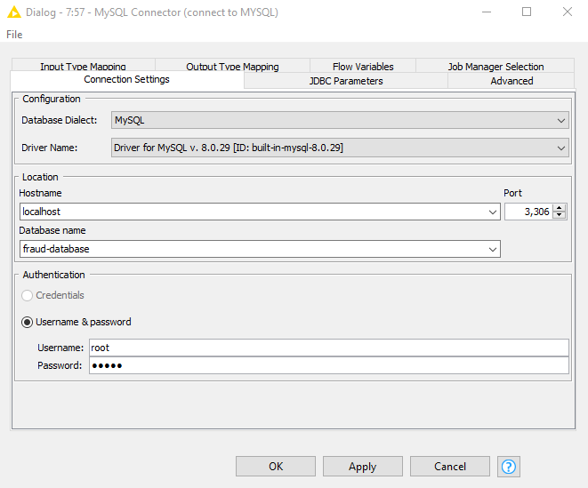
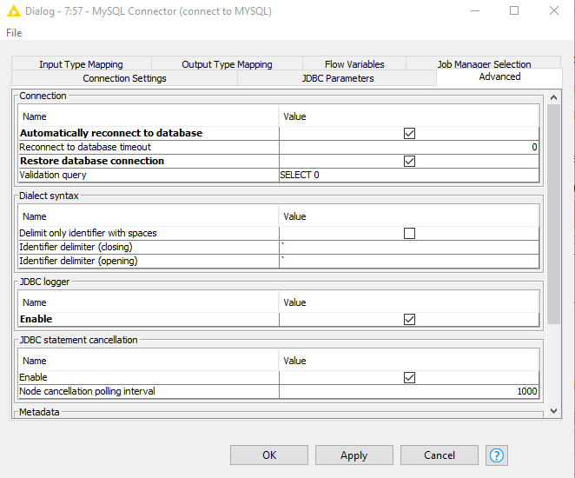
KAFKA PRODUCER WORKFLOW
MySQL Connector Node - connect to the database by providing hostname & database name

Slide 26
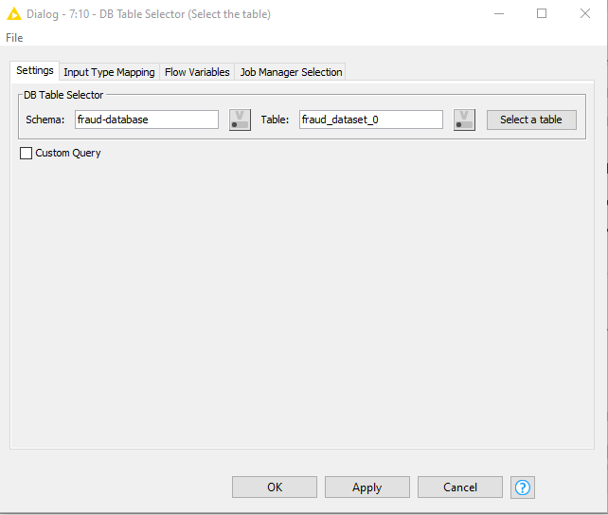
KAFKA PRODUCER WORKFLOW
DB Table Selector Node - table selection in the database schema
DB Reader Node - Executes the input query in the database and retrieves the result into a KNIME data table.

Slide 27
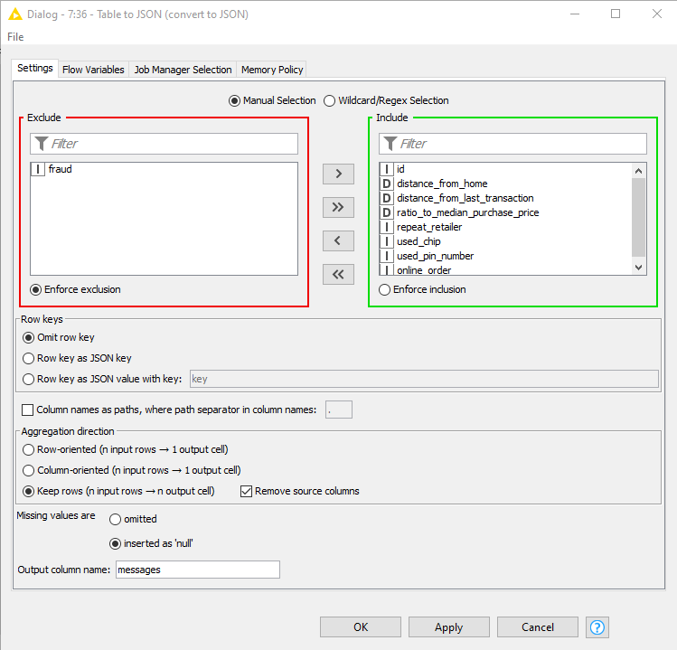
KAFKA PRODUCER WORKFLOW
Table to JSON Node - Converts the selected columns content to a JSON value row-wise or column-wise.
Notes:
O

Slide 28
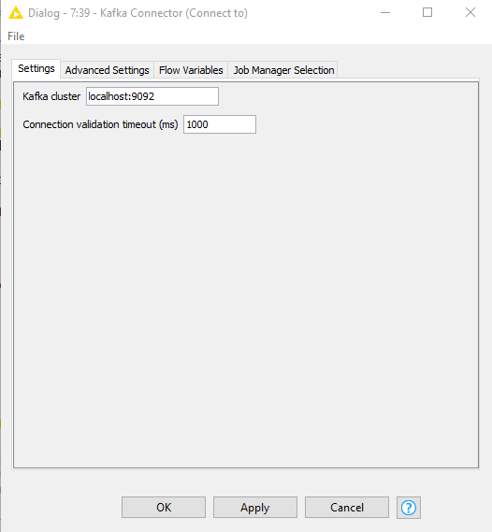
KAFKA PRODUCER WORKFLOW
Kafka Connector - define the information that is needed to establish a connection with a Kafka cluster

Slide 29
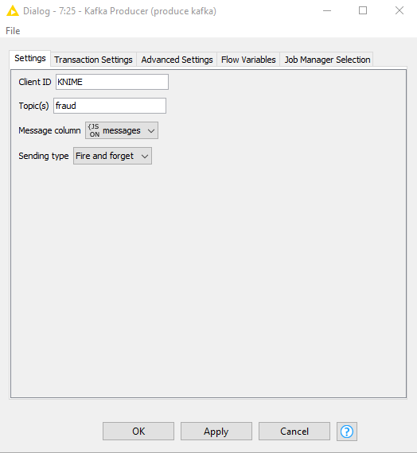
KAFKA PRODUCER WORKFLOW
Kafka Producer Node - This node allows to send messages to Kafka.

Slide 30
KAFKA PRODUCER WORKFLOW
More on Kafka Configuration can be found via this link.

Slide 31
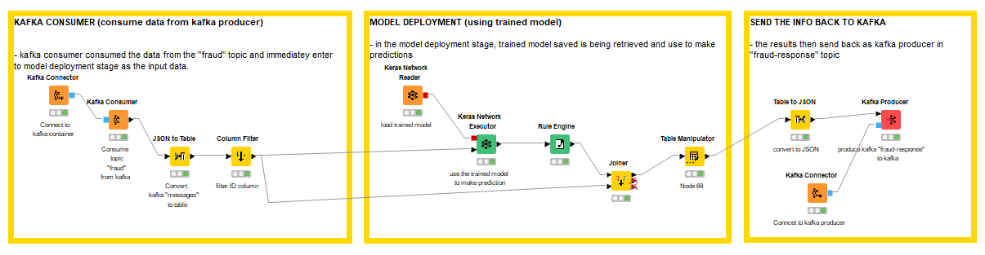
MODEL DEPLOYMENT
Model deployment workflow start with kafka consumer consumed the message from kafka producer in the “fraud” topic then the JSON file converted to Knime table
6
11
1
2
7
13
3
8
10
5
9
12

Slide 32

MODEL DEPLOYMENT
Kafka Connector - define the information that is needed to establish a connection with a Kafka cluster
Note: You have to setup and install kafka first

Slide 33
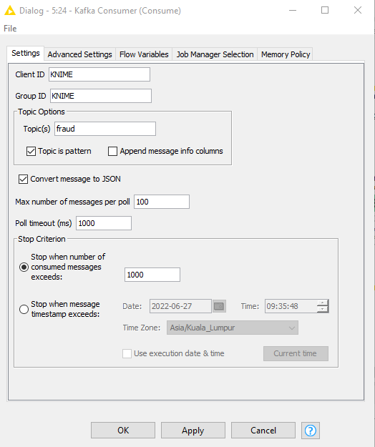
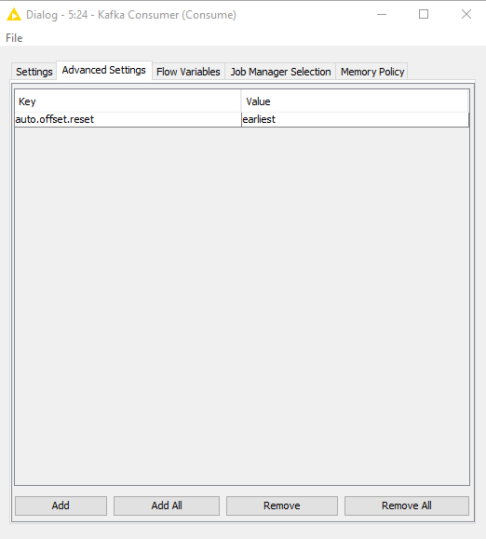
MODEL DEPLOYMENT
Kafka Consumer - consume messages from a Kafka cluster for given topics and to store them in a table

Slide 34
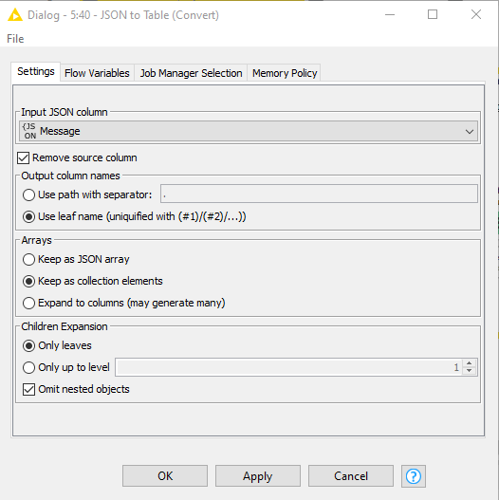
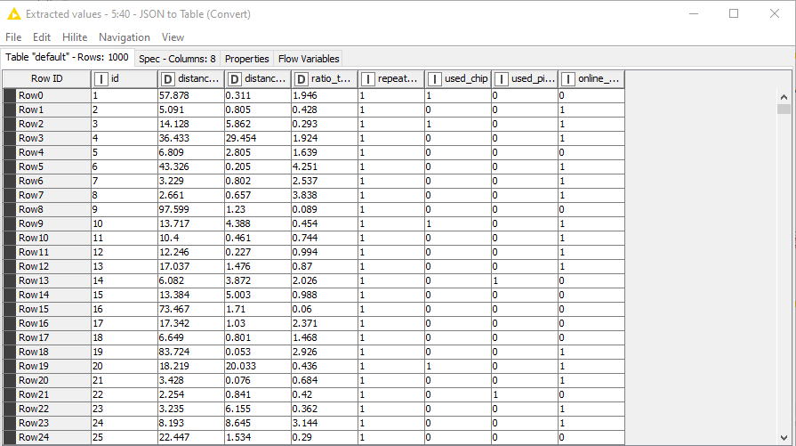
MODEL DEPLOYMENT
JSON to Table - Converts a JSON column to multiple columns
OUTPUT TABLE

Slide 35
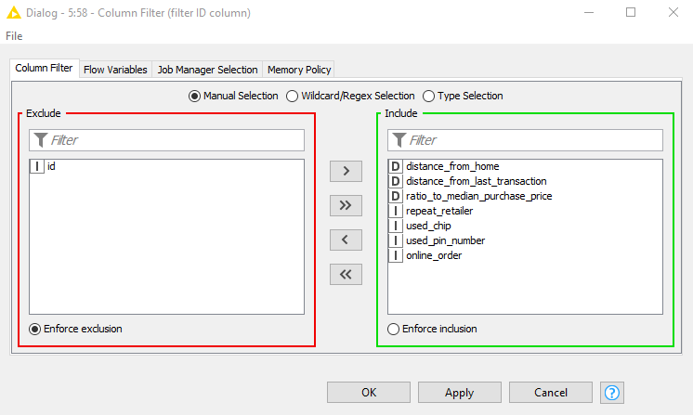
MODEL DEPLOYMENT
Column Filter - allows columns to be filtered from the input table while only the remaining columns are passed to the output table.

Slide 36
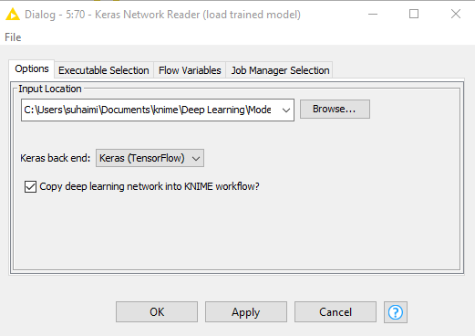
MODEL DEPLOYMENT
Keras Network Reader - reads a Keras deep learning network from an input file. The file can either contain a full, pre-trained network (.h5 file) or just a network specification without weights (.json or .yaml file).

Slide 37
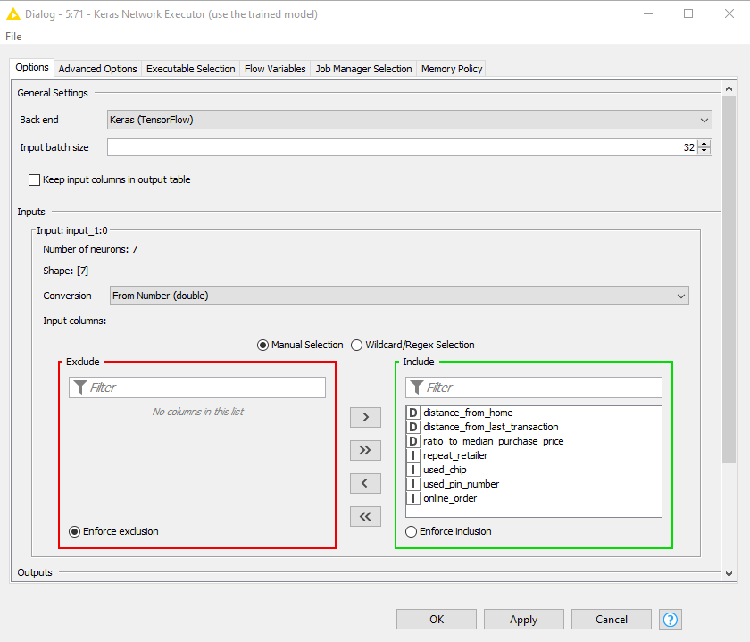
MODEL DEPLOYMENT
Keras Network Executor - executes a Keras deep learning network on a compatible external back end that can be selected by the user

Slide 38
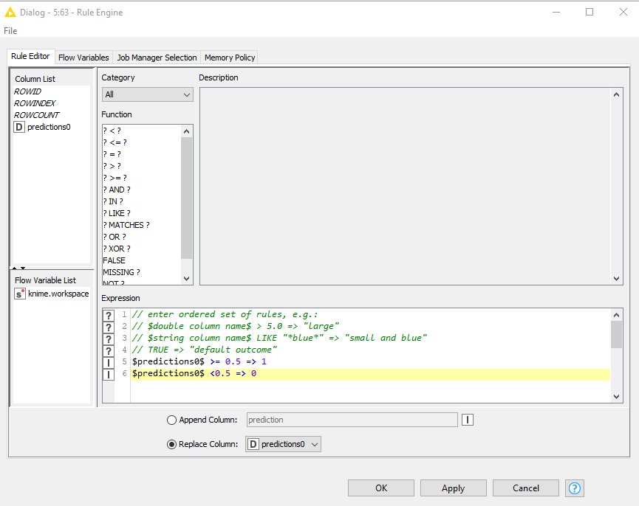
MODEL DEPLOYMENT
Rule Engine - This node takes a list of user-defined rules and tries to match them to each row in the input table
Notes:
http://theprofessionalspoint.blogspot.com/2019/05/activation-squashing-functions-in-deep.html

Slide 39
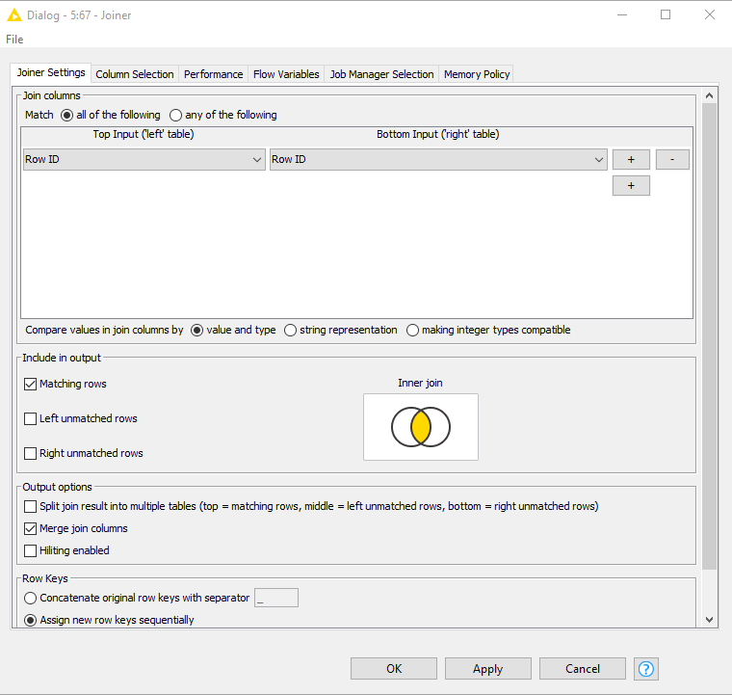
MODEL DEPLOYMENT
Joiner - This node combines two tables similar to a join in a database

Slide 40
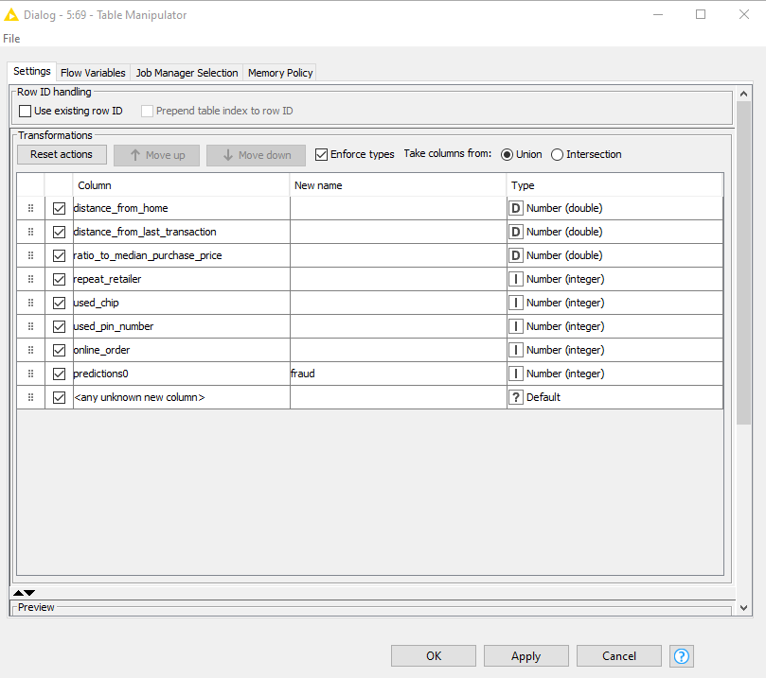
MODEL DEPLOYMENT
Table Manipulator - Allows to perform several column transformations on any number of input tables such as renaming, filtering, re-ordering and type changing of the input columns.

Slide 41
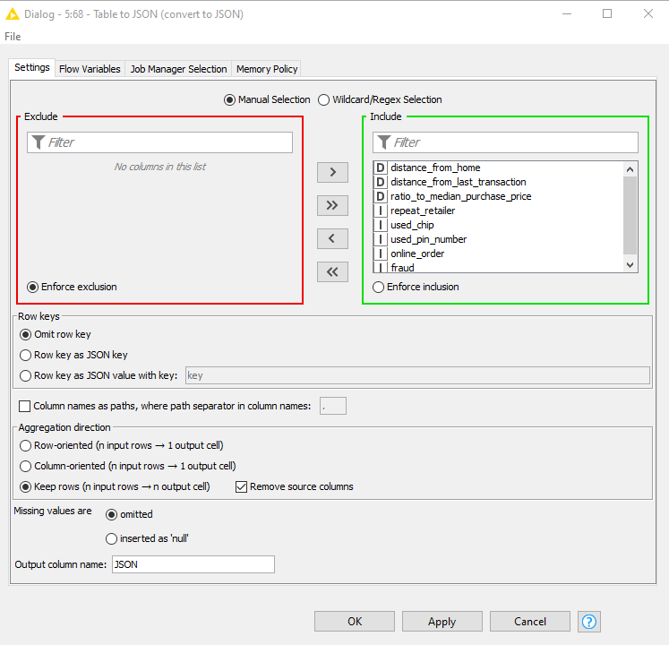
MODEL DEPLOYMENT
Table to JSON - Converts the selected columns content to a JSON value row-wise or column-wise

Slide 42
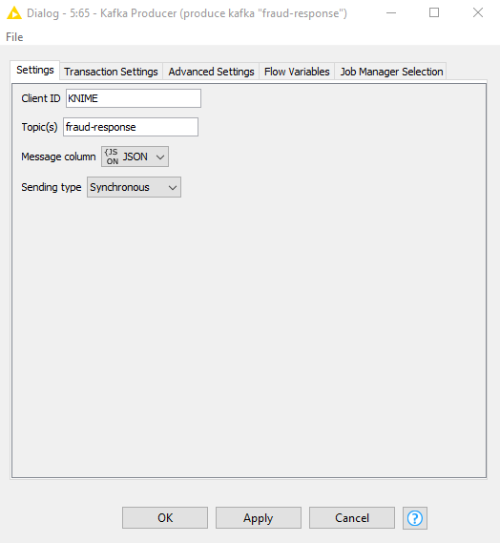
MODEL DEPLOYMENT
Kafka Producer - This node allows to send messages to Kafka.

